Slide 1
Logic and design methodology second stage
University of Diyala
College of Engineering
Department of Architecture
2022-2023

Slide 2
The Greek thought: Socrates, Plato and Aristotle
Greek civilization was the roots and the basis for all later European civilization.
Athens was the center of this civilization.
During this period there were great development in music, poetry, drama, medicine, painting, sculptures ...etc.
The basic contribution of the Greeks was that they idealized man (human forms).

Slide 3
There were two kinds of men: mortal and immortal.
There were twelve main gods called (Olympian gods) , because they lived in (mount Olympus) which was the traditional home of Greek gods.
Man and his gods were the focal point of Greek civilization, and from that emerged the great philosophers who gave birth to logic.

Slide 4
At the end of fifth century B.C., a flood of new ideas poured into Athens.
Advanced thinkers began to reject the traditional explanations of the world of nature and the religious beliefs declined.
Gods and goddesses were no longer held in same regards as they had been a century before.

Slide 5
Generally; philosophy came into existence when the Greeks discovered their dissatisfaction with supernatural and mythical explanation of reality.
Then Greek thinkers began to suspect a rational or logical order to the world, and from there emerged the vital role of philosophy and logic.

Slide 6
The origin of the word (philosophy) was from the Greek words; Philo (love) and Sophos (wisdom).
Logic was derived from the Greek word “Logike” (art of reason).

Slide 7
Pre Socratic Philosophers
The Sophists (السفسطائية):
Were men whose responsibility was train and educate the Sons of Athenian citizens by the “walk and talk technique”.
There main concern was to teach the “art of persuasion (الاقناع) ” by the act of argument.
There aim was: find a better understanding of the world, the gods and man, by the mythical(الاسطورية) beliefs.

Slide 8
Three Greek philosophers who gave birth to logic.
Socrates (469-399 B.C.):
The father of philosophers, come for sophists.
He was the noblest and wisest Athenian and love the wisdom.
His principle was “know thyself” or “know yourself”.
He teach the people especially the Young “the Youth of Athens”.

Slide 9
He changed his student to think for themselves, to use their mind to answer questions.
He urged them to the act of argument leading them to the truth: to the knowledge of good and evil, the wisdom of life.
He teach the truth by reasons “nothing should be taken for granted”.

Slide 10
His ideas had great influence on the youth of Athens.
The government was afraid that Socrates ideas would lead to rebellion التمرد)).
He was trialed, charged with impiety and treasons (الخيانات), he sentenced to death.
He drank the fatal dose of hemlock (poison) to die.

Slide 11
Socrates famous quotes:
Know thyself.
The only good is knowledge, and only evils is ignorance.
Wisdom begins in wonder (عجب).
I cant teach anybody anything, I can only make them think.
The only wisdom is in knowing you know nothing.

Slide 12
Plato (427-347 B.C.):
He was Socrates most famous students (Socrates knowledge came form his writing).
He founded a school of philosophy in honor of Socrates name “The academy”.

Slide 13
Plato's Books and dialogs
Mankind is born with knowledge:
His thoughts was in the fact; we don’t “learn” things in our daily experience but be “recollect” them. The knowledge is already there.
His job was not to teach the truth, but how to “pull” the truth out of the own minds.

Slide 14
Allegory (الرمز)of the Cave:
Its one of the best known to explain the nature of reality.
Plato demonstrates Socrates mot important idea: the difference between opinion and knowledge.
People are chained inside a cave can think that shadows of people and things are reality. One man escapes, discovers the real world, return to tell them but is ridiculed (السخرية) .

Slide 15
Ordinary people (prisoners (سجناء) of the cave) use their senses . They observe copies and illusions of people and things. The from opinions.
The philosopher (the man who escape the cave) uses his mind. To observe real, original and authentic things and people. He gains Knowledge.

Slide 16
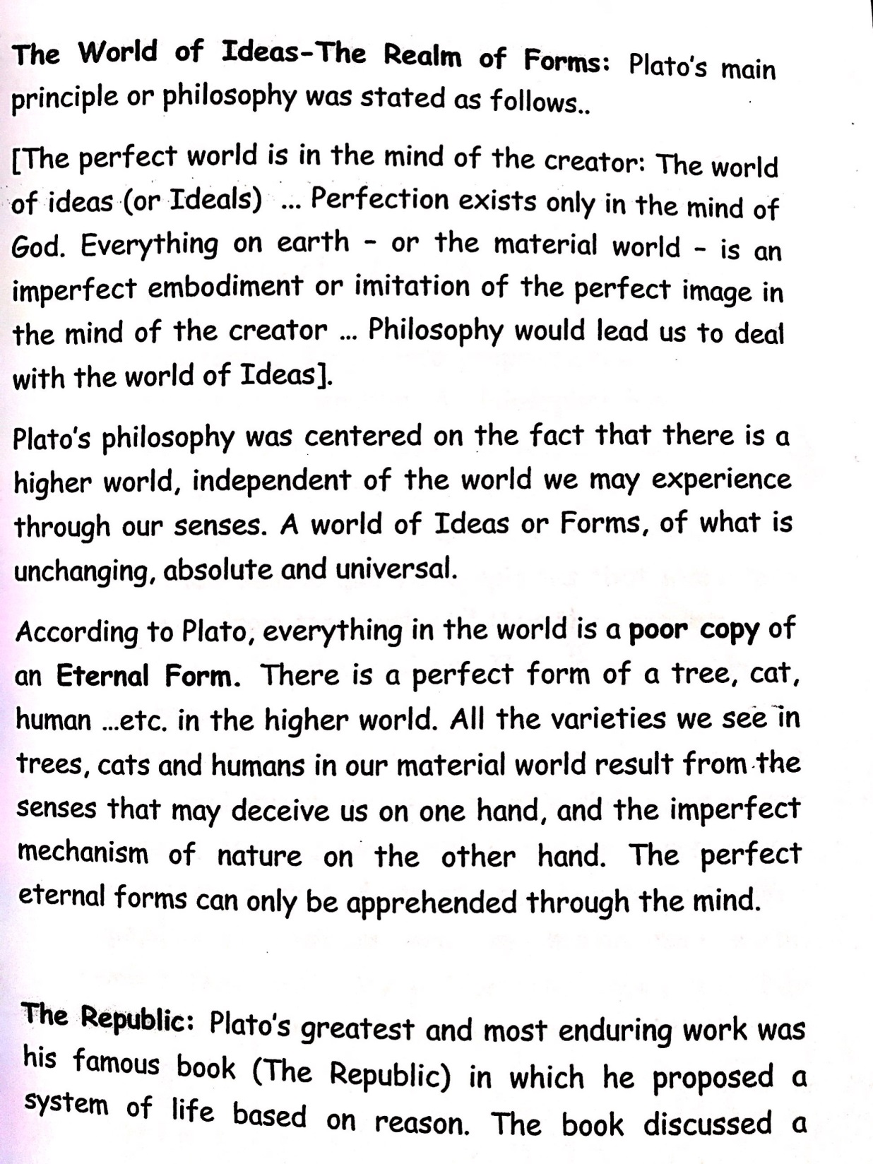
The world of ideas- the realm of forms:

Slide 17
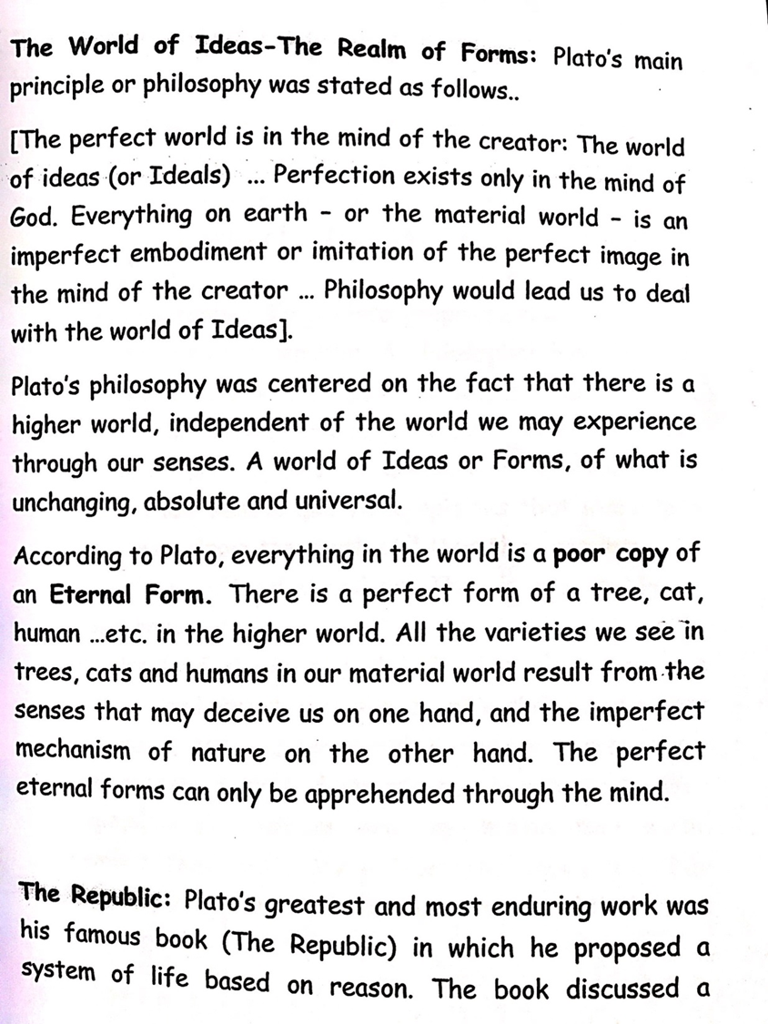

Slide 18
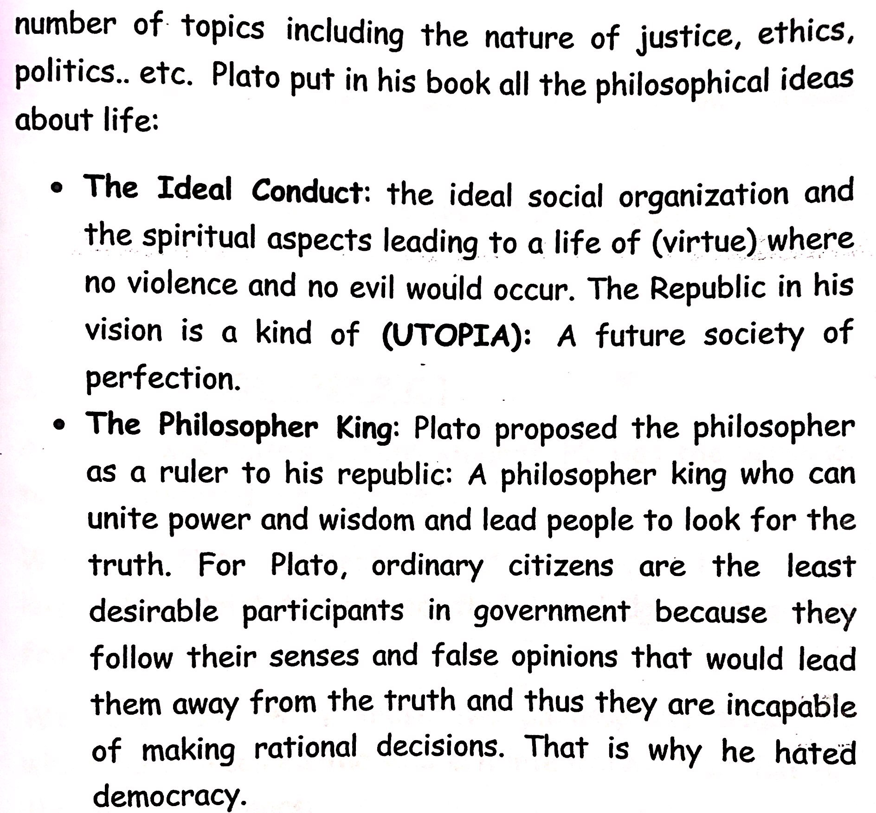

Slide 19

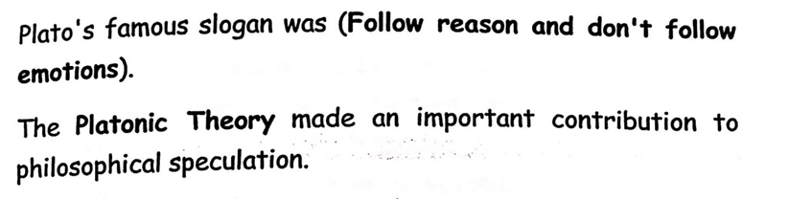

Slide 20
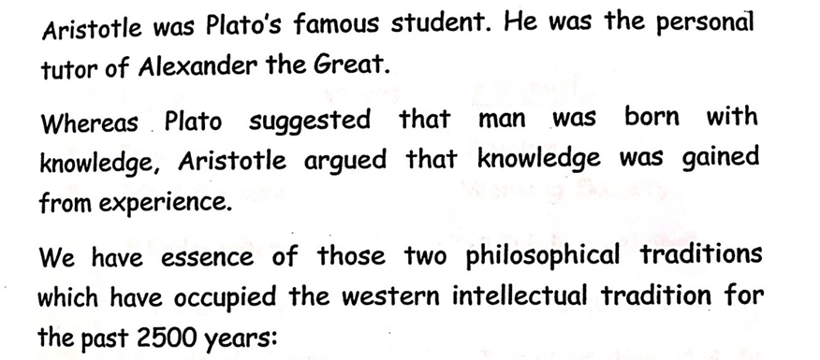
Aristotle (384-322 B.C):

Slide 21


Slide 22
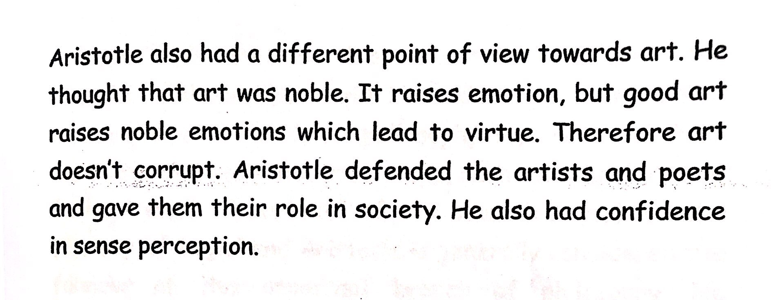

Slide 23
Plato versus Aristotle
Aristotle | Plato | No.
Realism | Idealism | 1-
Working society | Ideal society | 2-
Public participation | Philosopher king
Social justice | Social unity
Appreciation of art | Dismissal of art
Empiricism | Rationalism | 3-

Slide 24
Actually; Aristotle was the greatest philosopher and scientist of the ancient world.
He wrote on ethics, aesthetics, metaphysics, psychology, economics and politics. That was on the (logic of theory).
He developed a system of logic based on (Syllogism) القياس المنطقي.
His aim was to provide an instrument for scientific demonstration.

Slide 25
It was the logical nature of his mind that enabled him to make contributions to so many fields.
Aristotle influence upon all later western thought was immense.
Aristotle works had major influence on Islamic Philosophy as well.

Slide 26
Thank you for your attention

